Slide 1
Advanced Features in Prolog
Lecture Module 15

Slide 2
Objects in Prolog
Object is a collection of attributes. Treating related information as a single object is similar to records in conventional programming languages.
For instance, an object for address can be defined as address(Number, City, Zipcode, Country).
  Here entire address is treated as a single object and can be used as an argument of a predicate.
  address is called functor and Number, Street, City, Zipcode and Country are variables called components which hold actual values.

Slide 3
Example
Represent a fact “a lecture course on ‘ai', given on Monday from 9 to 11 in the morning by saroj kaushik in block 3, room 21” in Prolog.
Two representations as follows:
  course(ai, monday, 9,11, saroj, kaushik, block3, room21). (1)
  course (ai, time(monday,9,11), faculty(saroj, kaushik), location(block3, room21)). (2)
In representation (1), there is a relationship between eight items.
In (2) there is a relationship between four objects – a course name, a time, a faculty and a location.

Slide 4
Cont…
The four-argument version of course enables more concise rules to be written by abstracting the details that are relevant to the query.
Let us define few useful predicates using representation (2) for course facts.
/* faculty L teaches a course C.*/
teacher_course(L, C)
/* faculty L teaches a course C on day Day.*/
teacher_on_day(L,Day,C)
/* course C of D duration. */
duration(C, D)

Slide 5
Cont…
These predicates are defined as follows:
faculty_course(L, C) :- course(C,_, faculty(L,_),_).
faculty_on_day(L, Day, C) :- course(C,time(Day, _ , _),L , _).
duration(C, D) :- course(C,time(_,Start,Finish),_ ,_),
D is Finish – Start.
Note that the details not relevant in particular rule formation are hidden by putting underscore ( _ ).
This is called Data abstraction.
No definite rules to decide when to use structured data or not.

Slide 6
Cont…
Query: Who teaches ai course?
Goal: ?- faculty_course(L, ai).
?- faculty_course(L, ai).
?- course(ai, _, faculty(L,_), _ ).
{L = saroj}
succeeds Answer: L = saroj
Query: Which course does saroj teach?
Goal: ?- faculty_course(saroj, C).
    ?- faculty_course( saroj, C).
?- course(C, _, faculty(saroj, _), _ ).
{ C = ai}
succeeds Answer: C = ai

Slide 7
Binary Trees in Prolog
A binary tree is a finite set of elements that is either empty or is partitioned into two disjoint binary sub trees.
Representation of binary tree in Prolog:
b_node(Left_subtree, Root, Right_subtree),
  b_node is functor having three arguments.
  The first and last arguments are left and right subtrees of the original binary tree.
  Middle argument is the root of a binary tree.
The empty binary tree is represented by an atom called void.

Slide 8
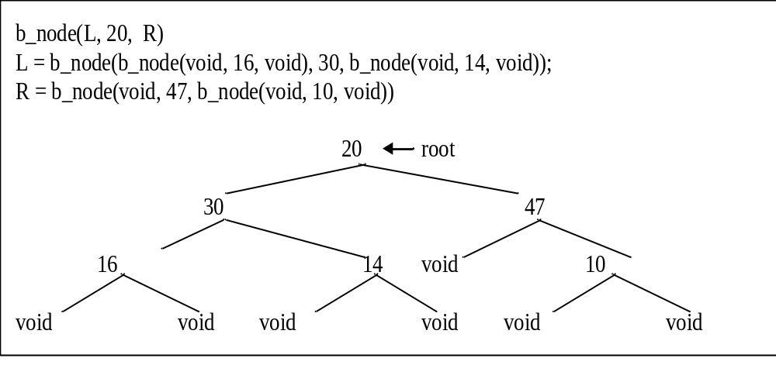
Prolog Representation of Binary Tree

Slide 9
Traversal of Binary Tree
Binary trees are traversed using recursion, mainly, in preorder, inorder and postorder.
  Preorder Traversal: visit root, traverse left subtree in preorder, right subtree in preorder.
  Inorder Traversal: traverse left subtree in inorder, visit root and right subtree in inorder.
  Postorder Traversal: traverse left subtree in postorder, right subtree in postorder and visit root.

Slide 10
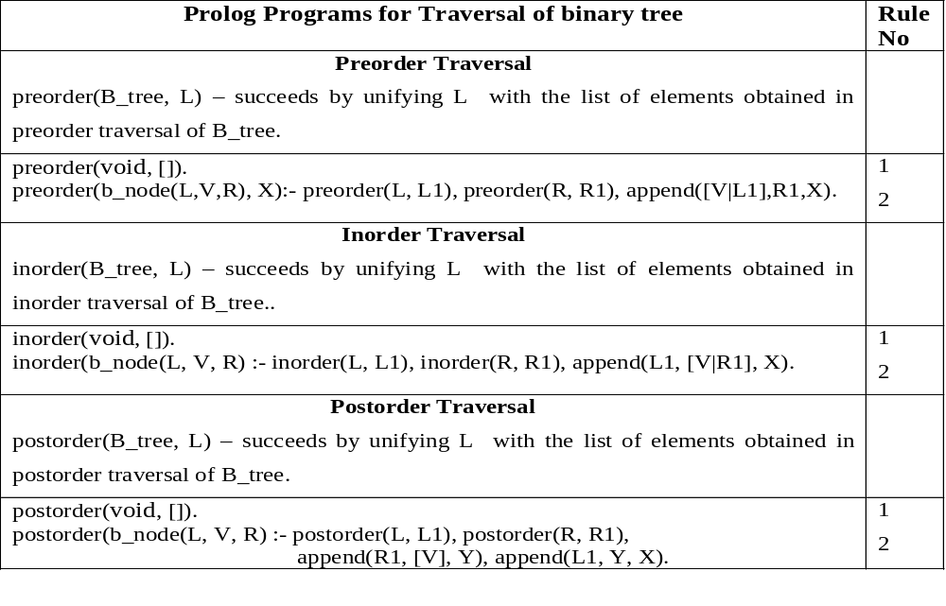

Slide 11
The System predicate "cut"
Prolog is non deterministic in nature.
Prolog provides a system defined predicate called cut (!)
  for affecting the procedural behavior of program and to limit the non determinism by preventing interpreter from finding alternative solutions.
  There are many applications, where the very first solution is of interest, if it exists.
Cut prunes the search tree and hence shortens the path traversed by Prolog interpreter.
It reduces the computation time and also saves storage space.
Semantically 'cut' always succeeds.

Slide 12
Example
Write a program that lists the users and library facilities open to them according to the following scheme.
facilities
basic additional
Reference, Borrowing Inter
Enquiry library loan
open to all users open to only those users who do not have any book overdue

Slide 13
Prolog Program using Cut
list(U, F) :- user(U), facility(U, F). (1)
facility(U, F) :- overdue(U, B), !, basic(F). (2)
facility (U,F) :- general((F). (3)
basic( ‘reference’).
basic(‘enquiry’).
general(F) :- basic(F). (4)
general(F) :- additional(F). (5)
additional (‘borrowing inter library loan’).
overdue ('S. K. Das', logic).
user ('S. K. Das').
user ('Rajan').

Slide 14
Use of Cut
In Prolog, the rules are of if-then type.
If we are interested in implementing if-then-else type of rule in Prolog, then we can make use of cut to do that.
Define a predicate named as if_then_else as follows:
/* if_then_else(U, Q, R)- succeeds by solving Q if U is
true else by solving R.*/
if_then_else(U, Q, R) :- U, !, Q.
if_then_else(U, Q, R) :- R.
Operationally it means that "prove U and if succeeds, then prove Q else prove R".
Declaratively, the relation if_then_else is true if U and Q are both true or if U is not true and R is true.

Slide 15
Types of Cut
There are two types of cuts viz., green cut and red cut.
Green cut : Does not affect the solution but affects the efficiency of the Prolog program.
  Removal of such cut does not change the meaning of the program.
Red cut: The cut whose removal from the program changes the meaning of the program.

Slide 16
Example
Write Prolog program for merging two ordered lists using green cut.
If we remove cuts from the rules, then the solutions are not affected and program does not change.
Here the cut is green.
/* merge(X, Y, Z) - Z is obtained by merging ordered lists X and Y. */
merge( [X|X1], [Y|Y1], [X|Z] ) :- X < Y, !,merge(X1, [Y|Y1], Z).
merge( [X|X1], [Y|Y1], [X, Y|Z] ):- X = Y, !, merge(X1, Y1, Z).
merge( [X|X1], [Y|Y1], [Y|Z] ) :- X > Y, merge( [X|X1], Y1, Z).
merge(X, [ ], X).
merge( [ ], Y, Y).

Slide 17
Example – Red cut (maximum of two numbers)
Version I – Red cut
% max(X, Y, Z) – Z is unified with maximum of X and Y.
max(X, Y, Z):- X ≥ Y, !, Z = X.
max(X, Y, Y) .
Cut’s removal will affect the solution.
Version 2 – Green cut
max(X, Y, Z):- X ≥ Y, !, Z = X.
max(X, Y, Y) :- X < Y.
Cut’s removal will not affect the solution.
Verify results using both versions with and without !
?- max(5, 4, 4).

Slide 18
Fail Predicate
Fail predicate is used for forced backtracking by failing a rule.
All the sub goals defined after fail will never be executed.
Hence predicate fail should always be used as the last sub goal in a rule.
It is to be noted that rule containing fail predicate will not produce any solution.

Slide 19
Example
Consider the following example to illustrate the use of fail predicate.
listing(Name, Address) :- emp(Name, Address).
emp(ram, cse).
emp(rita, maths).
emp(gita, civil).
Goal: ?- listing(Name, Address).
All possible solutions obtained on executing above goal by normal backtracking of Prolog are:
Name = ram , Address = cse;
Name = rita , Address = maths;
Name = gita , Address = civil;

Slide 20
Example – Cont…
listing :- write(‘Name‘), write( ‘ Address’), nl,
emp(Name, Address), write (Name), write(' '),write(Address), nl, fail. emp(ram, cse).
emp(rita, maths).
emp(gita, civil).
Goal: ?- listing
Name Address
ram cse
rita maths
gita civil

Slide 21
Cut and Fail Combinition
Cut and fail combination is also useful for expressing negative facts.
For example, "john does not like snakes" could be expressed by the following rule and fact.
like(john, snake) :- !, fail.
like(john, X).
This coding of rules state that "John likes everything except snake" which implies that "john does not like snakes".
Goal: ?- like(john, snake). Answer: no
Goal: ?- like(john, dog). Answer: yes

Slide 22
Iteration Looping
Iterative loops are important facility.
Even though it is not a system defined predicate, can be simulated in Prolog easily.
The predicate repeat (user defined predicate) creates a loop (similar to the loops in imperative programming language).
repeat.
repeat :- repeat.

Slide 23
Example
Let us design a login module which asks user his login name followed by password.
If password is not correct, it keeps on asking till correct password is given.
login :- getdata(_, _), writeln('You are logged on '),!.
login :- repeat, writeln('Sorry, you are not permitted'),
writeln('Try again: '), getdata(_, _),!,
writeln('You are now logged on').
getdata(N, P) :- write('Enter your login name: '), read(N), nl, write('Enter your password: '),
read(P), nl, user(N, P).
user(john, john1). user(mike, mike1).
user(mary, mary1). user(ram, ram1).

Slide 24
Database handling in Prolog
Two types of databases :- static and dynamic.
Static database is a part of the program that is complied along with it. It does not change during execution of the program.
Dynamic database can change dynamically at execution time and are of two types.
Type1: created at each execution. It grows, shrinks and is deleted at the end of program.
  This type of database is no longer available after program finishes its execution and is called working memory.

Slide 25
Cont…
Type2: Other type of dynamic databases are those which are stored in files and called database files.
  These are consulted in any program whenever required.
  These types of databases are not part of any particular program and are available for use in future by different programs using system defined predicates called save and consult.
  While executing a Prolog program one can load database file(s) using 'consult' predicate.
  These files can be updated dynamically at run time and saved using 'save' predicate.

Slide 26
Cont…
The format of predicates 'save' and 'consult' are as follows:
  save(filename) - succeeds after saving the contents of a file named 'filename'.
  consult(filename) - succeeds after loading or adding all the clauses from a file stored in 'filename' in the current program being executed.
  reconsult(filename) - succeeds after loading all the clauses by superseding all the existing clauses for the same predicate from a file 'filename'.
Grouping of rules and facts into partitions can be done easily.
Example: Load a file named 'more' if predicates P and Q succeed,
R :- P, Q, consult('more').

Slide 27
Cont…
Clauses can be added to a database at run time using following predicates.
asserta(X) & assertz(X) - succeed by adding fact X in the beginning & at the end of database of facts respectively.
For example, asserta(father(mike, john)) adds fact father(mike, john) in the beginning of current database.
Clauses can be constructed dynamically and asserted in a dynamic database as follows:
start :- writeln('Input name of mother: '), readln(M), writeln('Input name of child: '), readln(C), assert(parent(M, C)), assert(female(M)).

Slide 28
Cont…
Similarly obsolete clauses can be deleted by using system defined predicate called retract from dynamic database at the run time.
For example, retract(father(mike, X)) deletes the first fact father(mike, _) from working memory.
retractall(X) deletes all the clauses from a database whose head match with X.
Example, retractall(father(X, Y)) deletes all the facts father( _ , _ ) and retractall( _ ) deletes all the clauses from the working memory.

